Slide 1
Neighbourhood Project on
Bhuvan
KV Air Force Station,
Tughalakabad, New Delhi

Slide 2
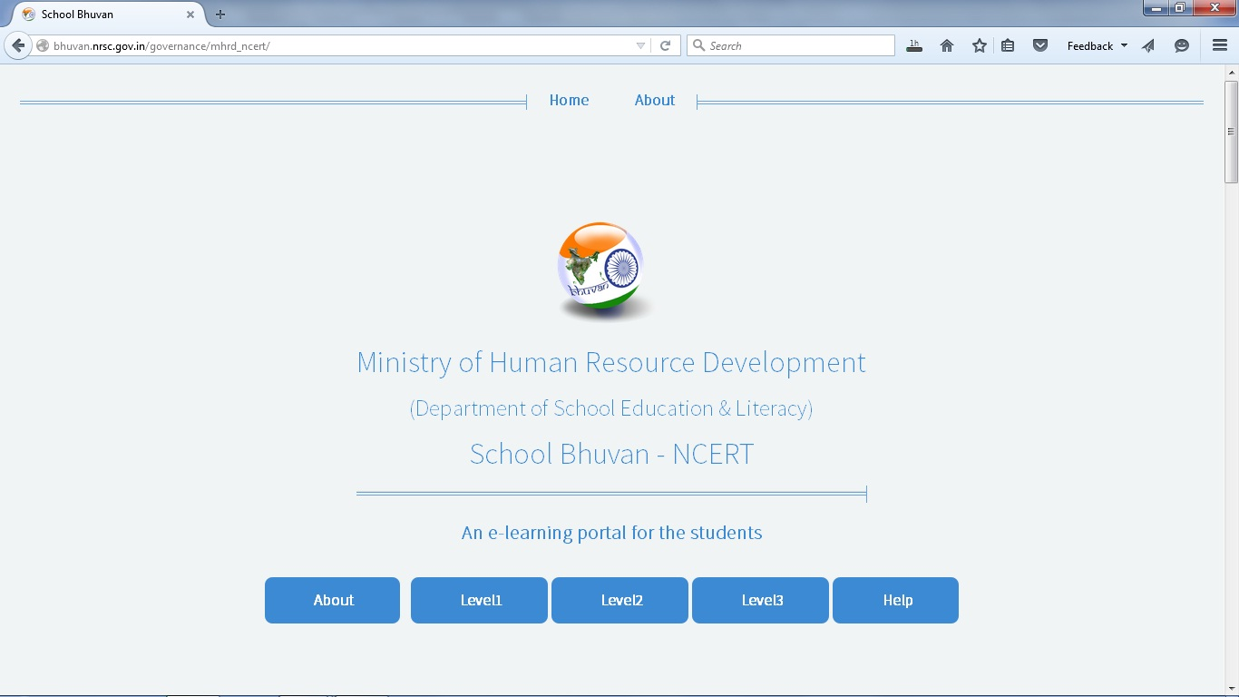
Open link -http://bhuvan.nrsc.gov.in/governance/mhrd_ncert
Click on level 3 and explore

Slide 3
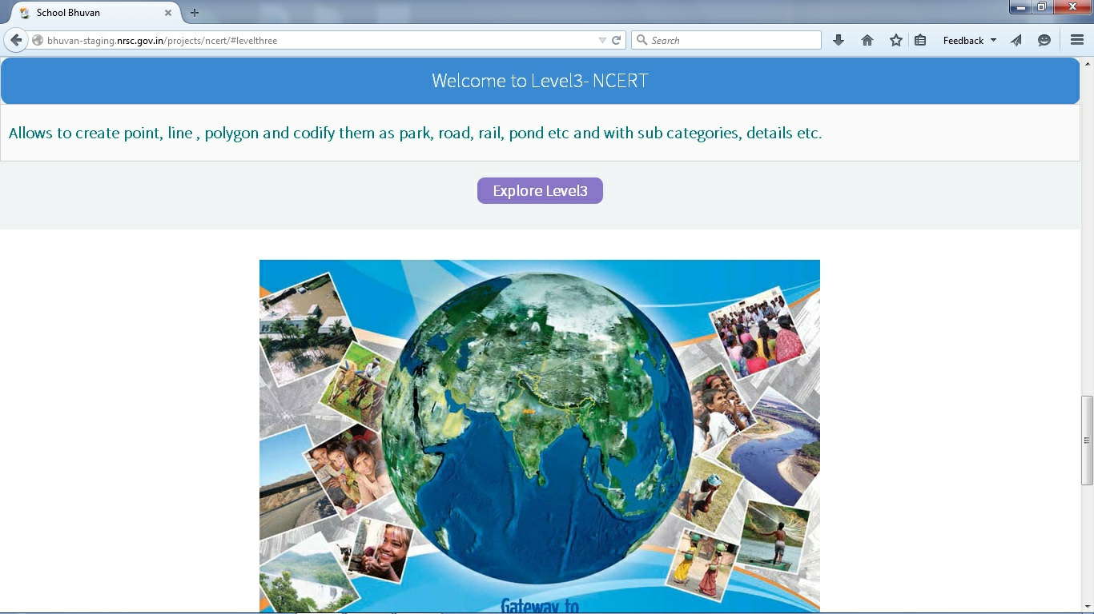
Click on explore 3

Slide 4
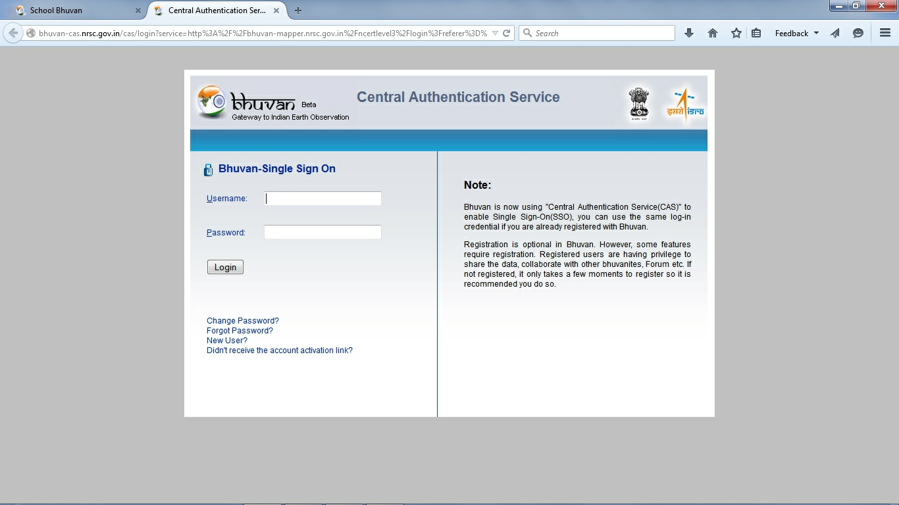
Registered in Bhuvan it takes few minutes

Slide 5
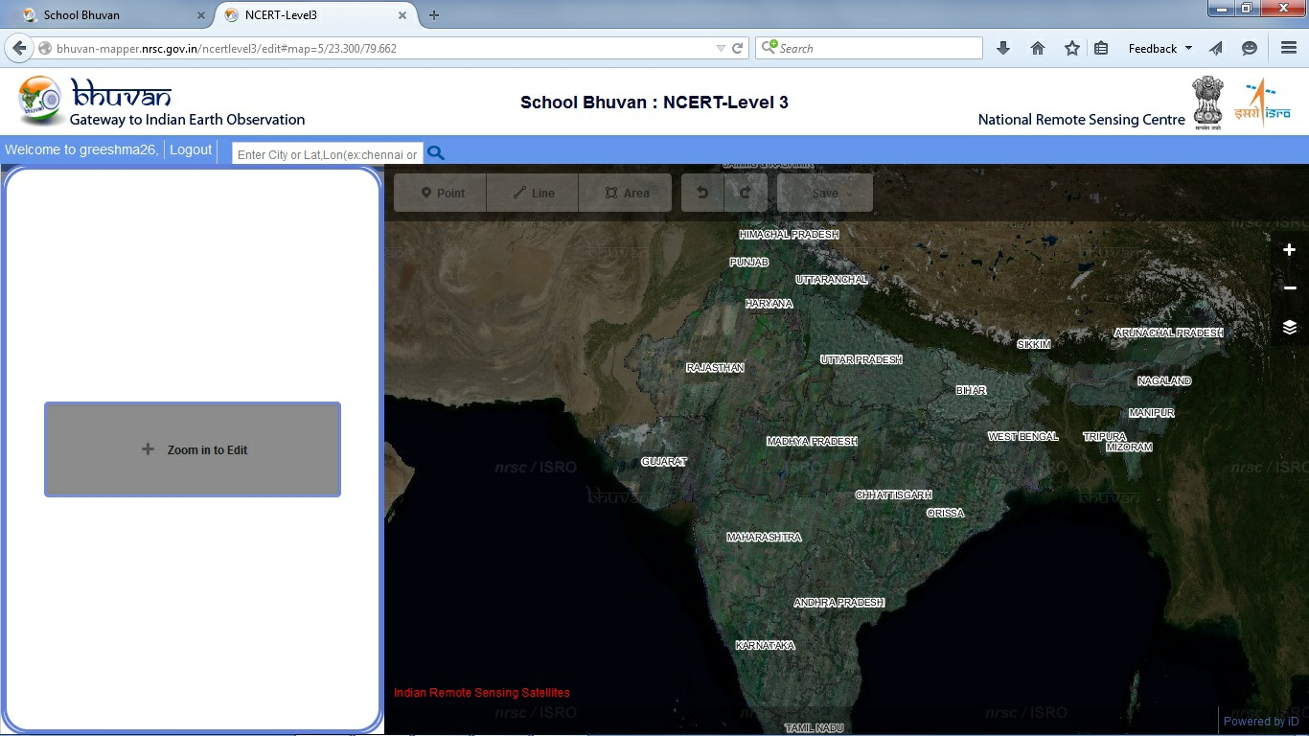
Click on “zoom in to edit” this will enable you to digitize

Slide 6
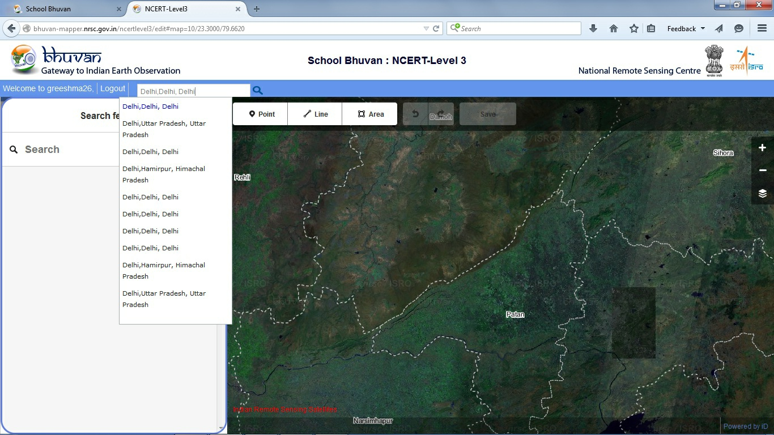
Enter the location where you have to digitize.

Slide 7
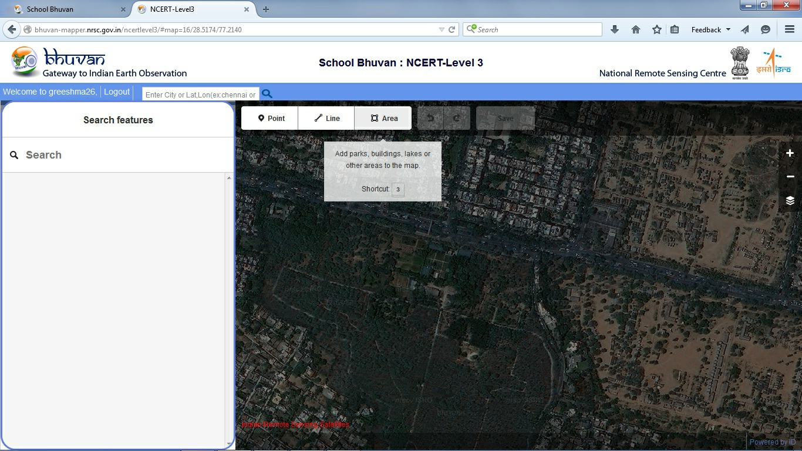
Click on area to digitize a building, lakes, areas,etc.

Slide 8
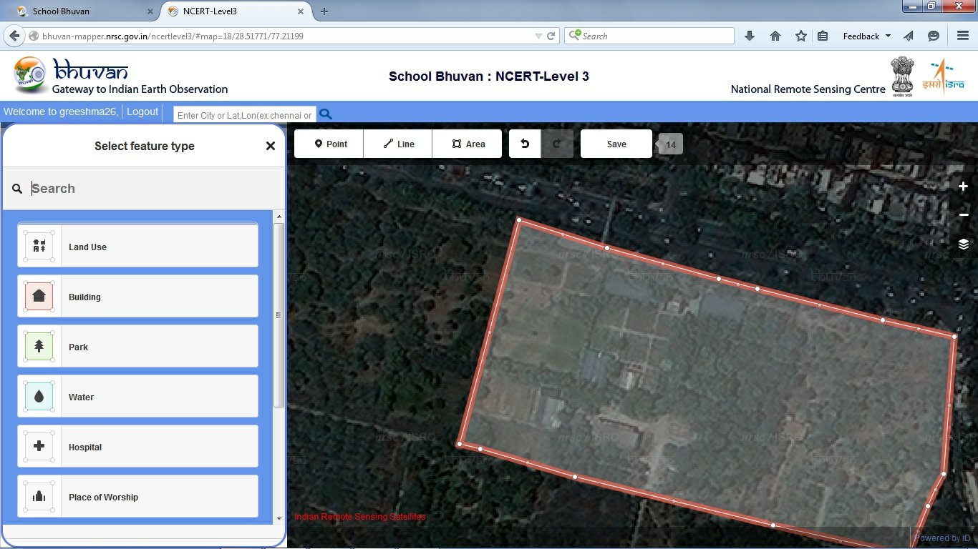
Select feature type after digitizing the feature

Slide 9
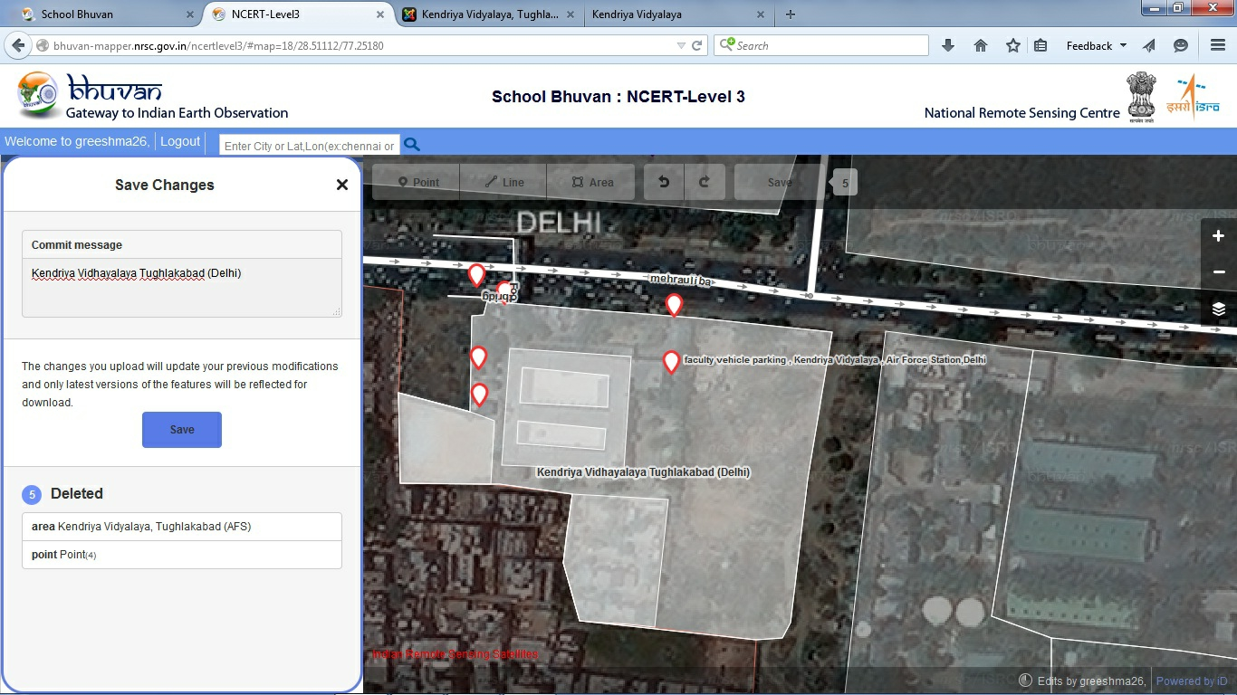
The changes will be uploaded when you click “SAVE”

Slide 10
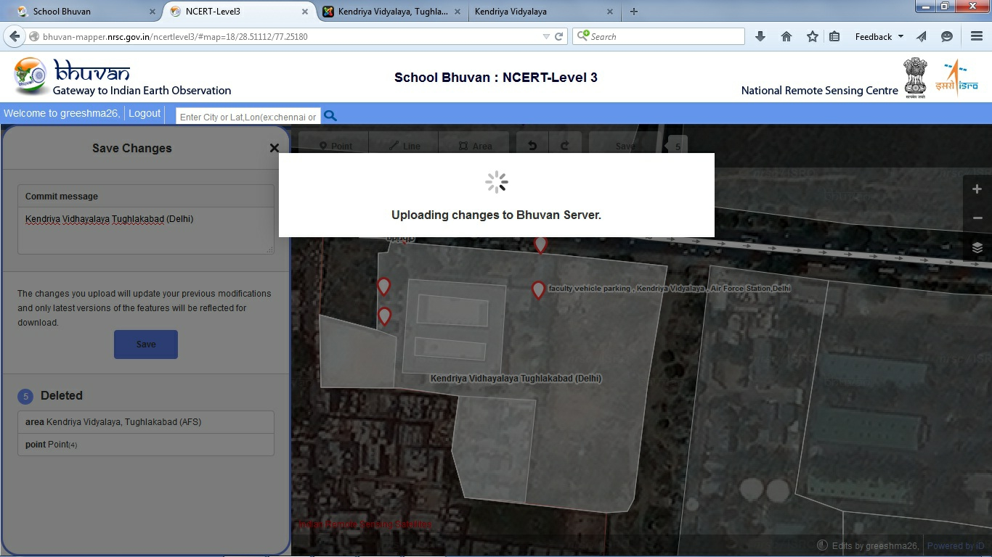
It will take few seconds to upload in the Bhuvan server

Slide 11
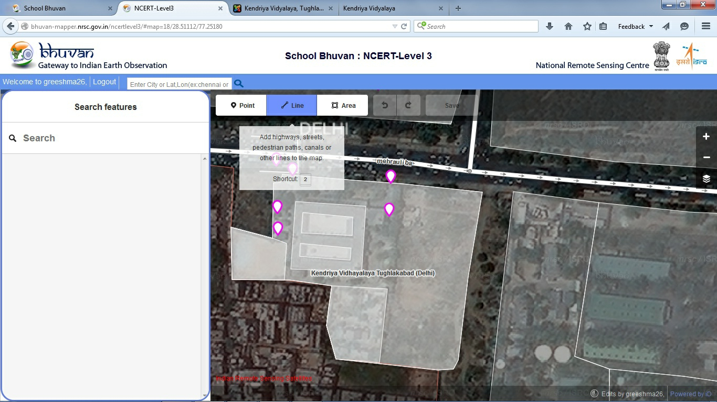
Click on line and draw linear features

Slide 12
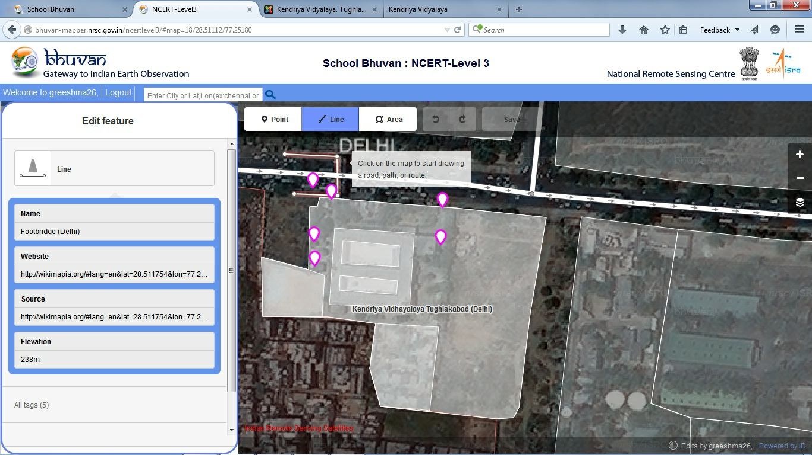
Enter data in the attribute table
Click on the map to start drawing

Slide 13
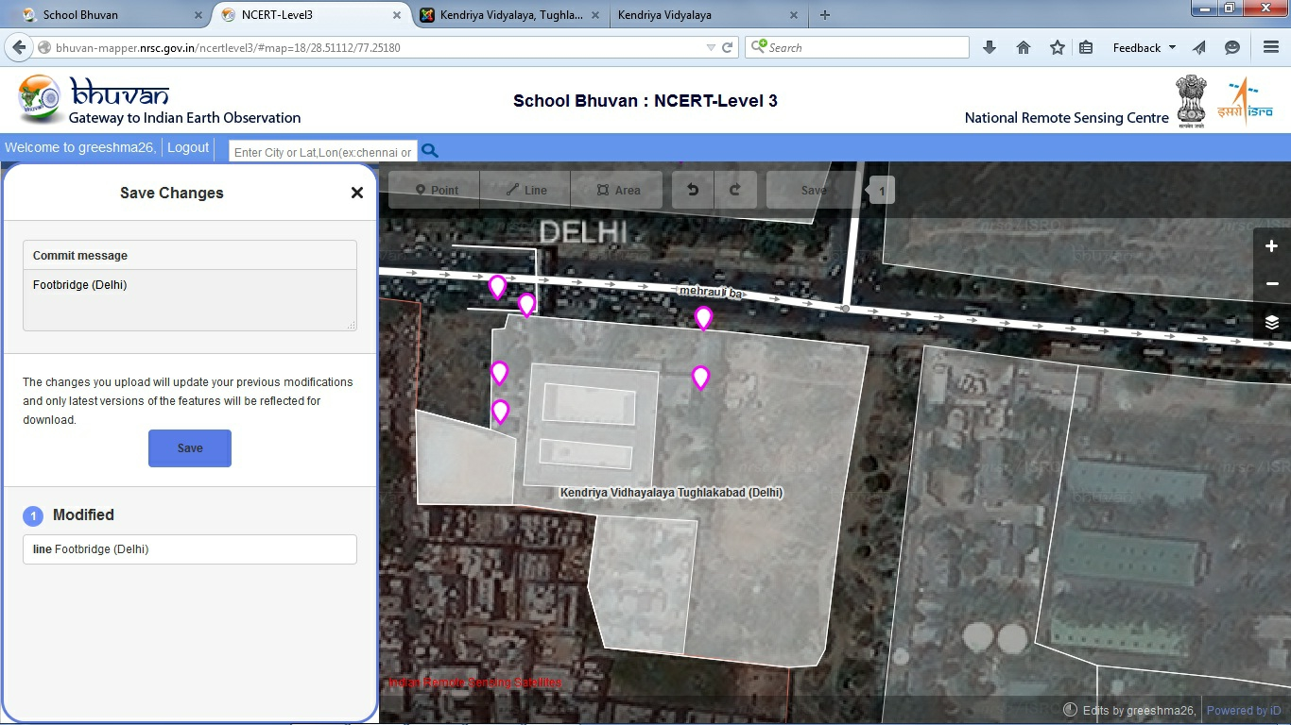
Save changes after digitizing

Slide 14
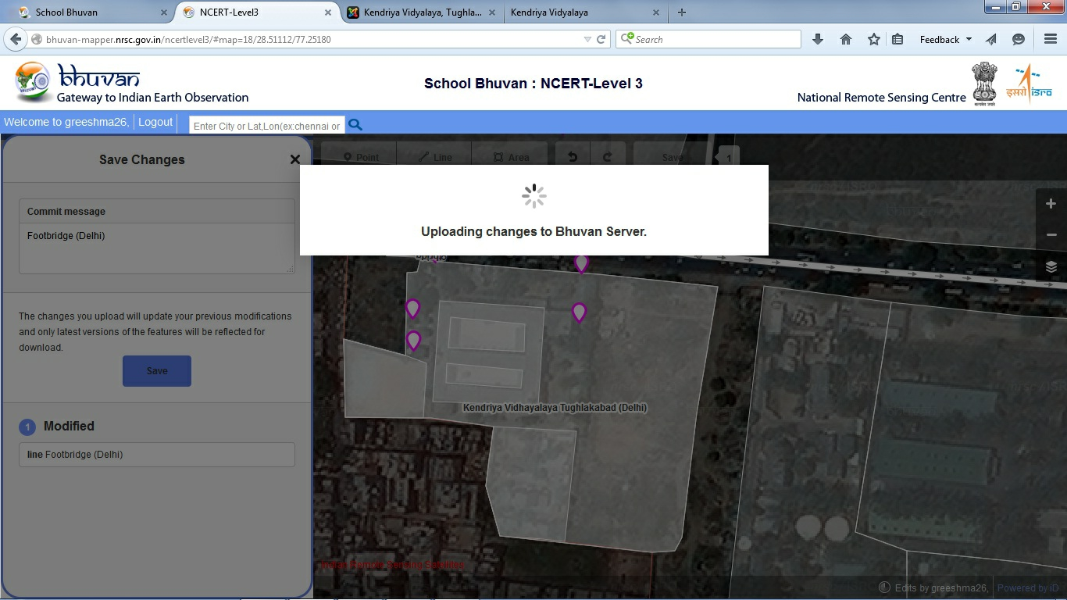
Click on save it will upload automatically

Slide 15
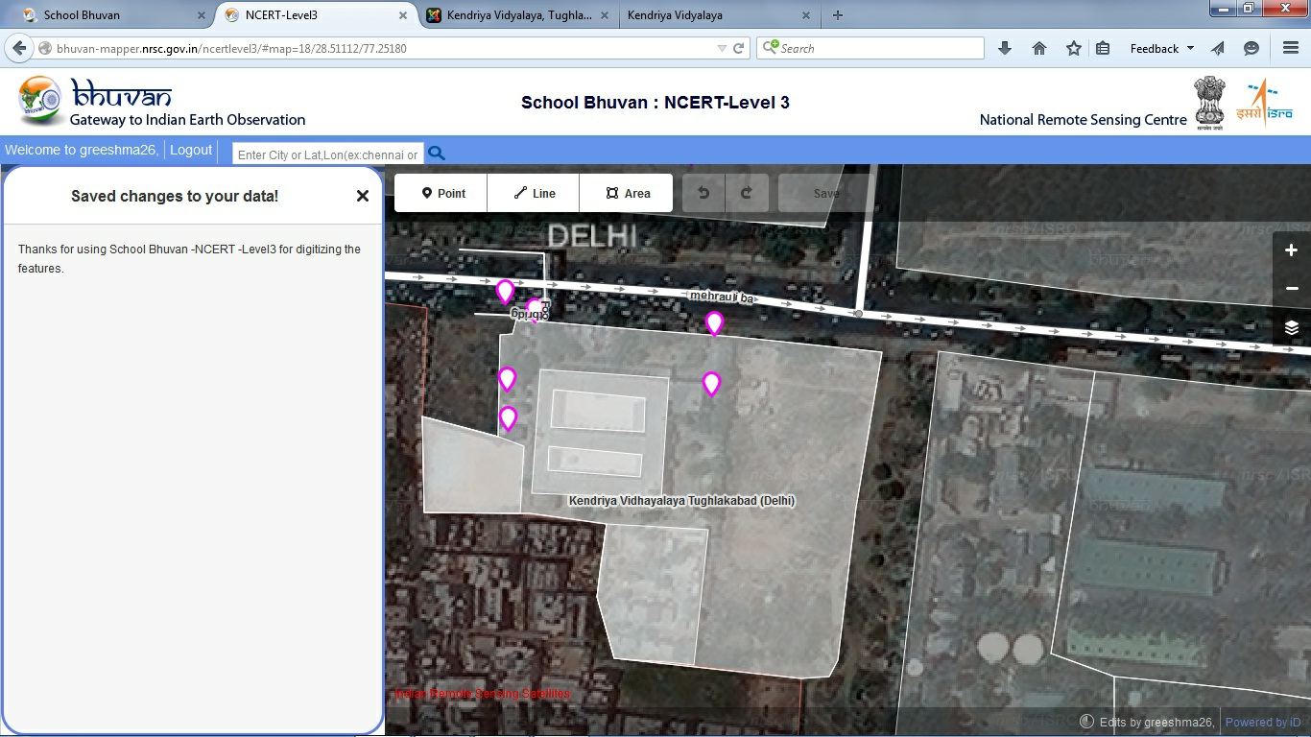
It will give information of using Bhuvan NCERT level 3 for digitizing the features

Slide 16
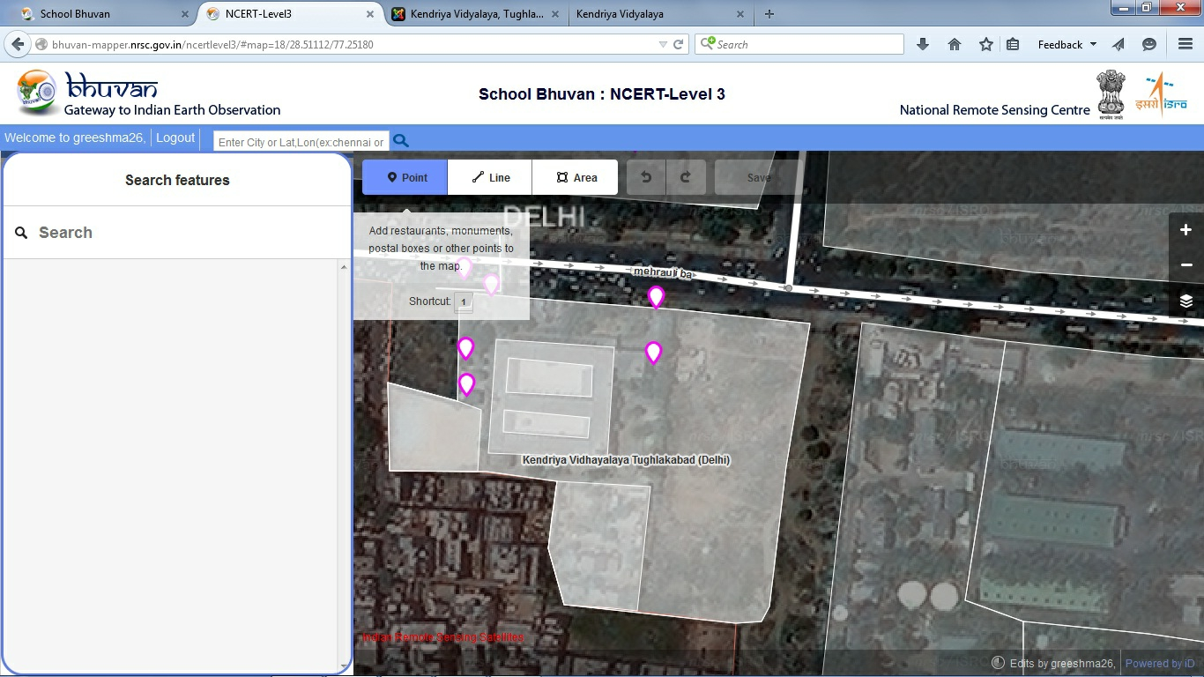
Select point to digitize

Slide 17
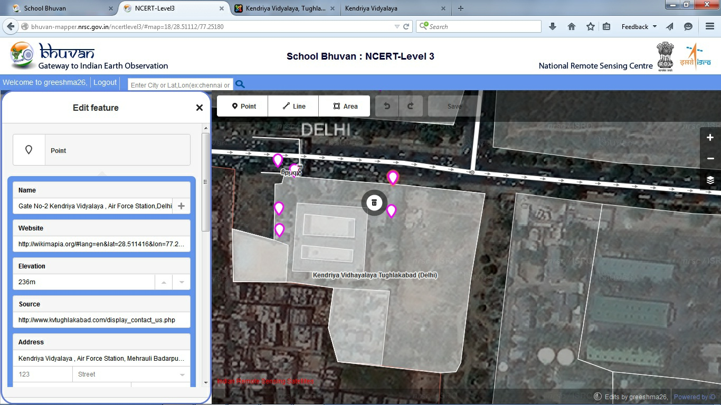
Enter data in the attributes

Slide 18

Save changes after digitizing

Slide 19
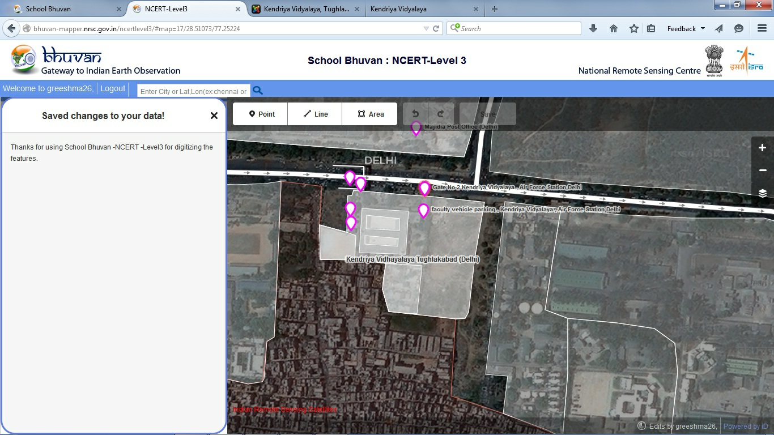
It will give information of using the Bhuvan NCERT level 3 for digitizing the features

Slide 20
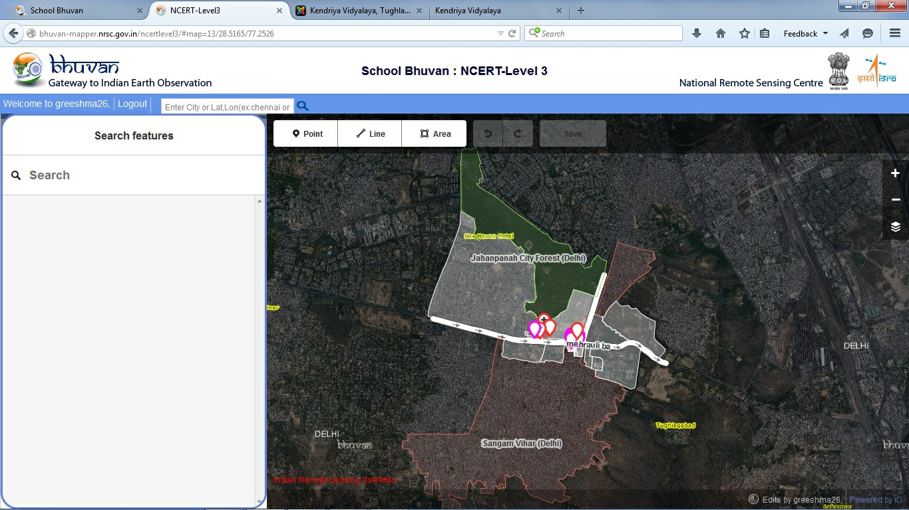
Final out put of KV AFS neighborhood project

Slide 21
Project Team
NCERT , New Delhi
&
NRSC, Hyderabad

